Slide 1


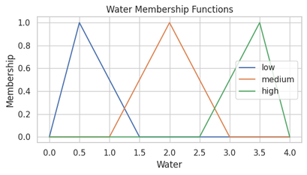
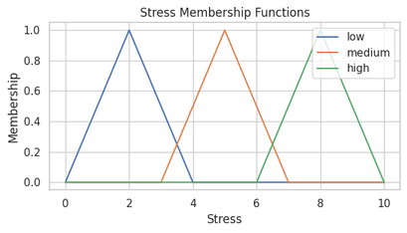
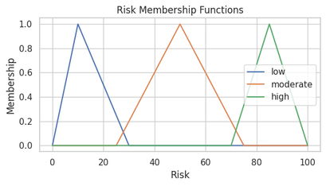
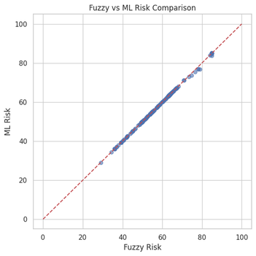
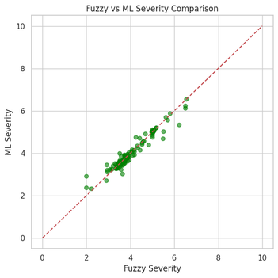
FUZZY-BASED DIGESTIVE HEALTH ASSESSMENT
Figure 1. Water Intake Membership FunctionsThe fuzzy system’s predictions were compared with general biological expectations about digestion. Both approaches aligned strongly: factors such as poor sleep, heavy meals, and acidity led to higher gas risk, while balanced routines reduced it. This comparison shows that the fuzzy model reflects real digestive physiology more closely than simple rule-of-thumb assessments, providing a structured interpretation that matches natural digestive behavior.
B PRANEETH
P V SRINAG
V MOHAN BALU
M SRI HARI
M VISHWAJITH
PROBLEM
CHALLENGES
RESULTS
People often experience gas, bloating, or acidity after eating and are left guessing whether the cause was something they ate, a lack of water, stress, or poor sleep. In reality, digestive discomfort is not triggered by a single factor but by the combined effect of daily habits, dietary patterns, lifestyle choices, and medical conditions. However, most existing approaches examine these influences separately, which means individuals rarely receive a clear explanation of what is truly affecting their digestive health. This creates the need for a unified and reliable method that can evaluate all relevant factors together, understand how they interact, and provide an understandable prediction of a person’s digestive gas risk.
Digestive health is influenced by many factors that do not act in isolation, making it difficult to understand how they collectively contribute to gas and discomfort. Many of these factors, such as sleep quality, stress, meal timing, and dietary habits, are subjective and hard to measure precisely. Medical conditions like acidity, gastritis, and IBS add further variability. Existing assessment methods often capture only parts of this picture and struggle to interpret vague or overlapping patterns. The main challenge is developing a system that can handle this uncertainty, combine all relevant information, and still produce clear, meaningful predictions that individuals can easily understand
The fuzzy system produced results that closely reflect natural digestive behavior. Individuals with healthy hydration, balanced meals, proper sleep, and low stress consistently showed lower gas risk, while those with irregular eating, high-fat foods, acidic conditions, or late dinners showed noticeably higher risk levels. These outcomes align with biological expectations, demonstrating that the system is able to translate real-life digestive influences into meaningful and reliable risk predictions.
FIGURE 1. WATER INTAKE MEMBERSHIP FUNCTIONS
FIGURE 2. STRESS QUALITY MEMBERSHIP FUNCTIONS
OBJECTIVE
PROPOSED METHOD
The objective of this project is to develop an intelligent and easy-to-understand system that can evaluate a person’s lifestyle, diet, sleep patterns, stress levels, and medical conditions together rather than separately. By bringing these factors into a single framework, the system aims to provide a more accurate and meaningful prediction of digestive gas risk, the potential severity of discomfort, and how this risk may progress over time. The goal is to offer individuals a clearer understanding of what influences their digestive health and support early awareness, better decision-making, and healthier habits.
The method begins by recognizing that digestive discomfort develops through multiple interacting processes within the digestive system. To capture this complexity, the model brings together lifestyle habits, food patterns, medical symptoms, and age-related factors into a unified assessment framework. Each input is translated into meaningful categories such as low, moderate, or high, based on how the digestive system naturally responds to these influences. These categories are then interpreted using structured fuzzy rules that reflect real-world digestive behavior. This approach allows the system to evaluate how different habits combine to increase or reduce digestive gas risk in a way that aligns with biological understanding.
COMPARATIVE ANALYSIS
FIGURE 3. DIGESTIVE GAS RISK MEMBERSHIP FUNCTIONS
The fuzzy system’s predictions were compared with general biological expectations about digestion. Both approaches aligned strongly: factors such as poor sleep, heavy meals, and acidity led to higher gas risk, while balanced routines reduced it. This comparison shows that the fuzzy model reflects real digestive physiology more closely than simple rule-of-thumb assessments, providing a structured interpretation that matches natural digestive behavior.
FIGURE 4. FUZZY VS ML RISK COMPARISON
FIGURE 5. FUZZY VS ML SEVERITY COMPARISON

Slide 2
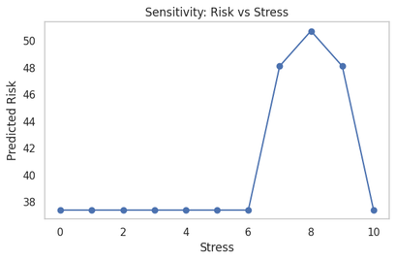
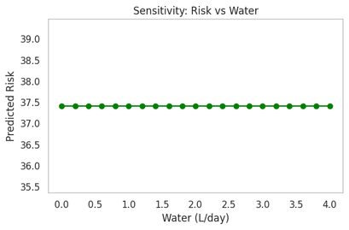
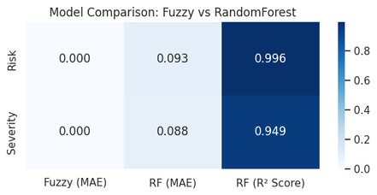
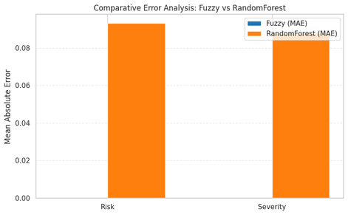
FUZZY-BASED DIGESTIVE HEALTH ASSESSMENT
B PRANEETH
P V SRINAG
V MOHAN BALU
M SRI HARI
M VISHWAJITH
PROBLEM
CHALLENGES
RESULTS
People often experience gas, bloating, or acidity after eating and are left guessing whether the cause was something they ate, a lack of water, stress, or poor sleep. In reality, digestive discomfort is not triggered by a single factor but by the combined effect of daily habits, dietary patterns, lifestyle choices, and medical conditions. However, most existing approaches examine these influences separately, which means individuals rarely receive a clear explanation of what is truly affecting their digestive health. This creates the need for a unified and reliable method that can evaluate all relevant factors together, understand how they interact, and provide an understandable prediction of a person’s digestive gas risk.
Digestive health is influenced by many factors that do not act in isolation, making it difficult to understand how they collectively contribute to gas and discomfort. Many of these factors, such as sleep quality, stress, meal timing, and dietary habits, are subjective and hard to measure precisely. Medical conditions like acidity, gastritis, and IBS add further variability. Existing assessment methods often capture only parts of this picture and struggle to interpret vague or overlapping patterns. The main challenge is developing a system that can handle this uncertainty, combine all relevant information, and still produce clear, meaningful predictions that individuals can easily understand
The results clearly showed how different causes contribute to digestive discomfort. Spicy, oily, and junk foods increased gas risk, especially when combined with poor sleep or high stress. Medical conditions like acidity and gastritis showed an even stronger effect on severity levels. The model successfully highlighted which factors had the greatest impact, helping users understand the specific behaviors and conditions that elevate their risk.
OBJECTIVE
PROPOSED METHOD
FIGURE 4. SENSITIVITY ANALYSIS OF STRESS ON DIGESTIVE GAS RISK
FIGURE 5. SENSITIVITY ANALYSIS OF WATER INTAKE ON DIGESTIVE GAS RISK
The objective of this project is to develop an intelligent and easy-to-understand system that can evaluate a person’s lifestyle, diet, sleep patterns, stress levels, and medical conditions together rather than separately. By bringing these factors into a single framework, the system aims to provide a more accurate and meaningful prediction of digestive gas risk, the potential severity of discomfort, and how this risk may progress over time. The goal is to offer individuals a clearer understanding of what influences their digestive health and support early awareness, better decision-making, and healthier habits.
The method focuses on identifying how various causes of digestive discomfort interact with one another. Instead of evaluating diet, stress, sleep, or medical conditions independently, the system analyzes them together through a fuzzy-logic approach. Each factor is represented in ranges that mimic real human experiences such as “poor sleep,” “high stress,” or “frequent oily foods.” These inputs are processed through a network of fuzzy rules that reflect the known relationships between lifestyle behavior and gas formation. By combining these influences, the method produces a risk level that more accurately represents an individual’s overall digestive health.
COMPARATIVE ANALYSIS
The system’s results were compared with known digestive health cause-and-effect patterns. Behaviors commonly associated with discomfort—such as oily foods, late dinners, and high stress—showed elevated risk levels in the model, confirming consistency with established digestive health understanding. This demonstrates that the fuzzy method captures real-world cause relationships more reliably than isolated symptom-based assessments.
FIGURE 6. FUZZY VS RANDOMFOREST
FIGURE 7. COMPARATIVE ERROR ANALYSIS BAR CHART

Slide 3
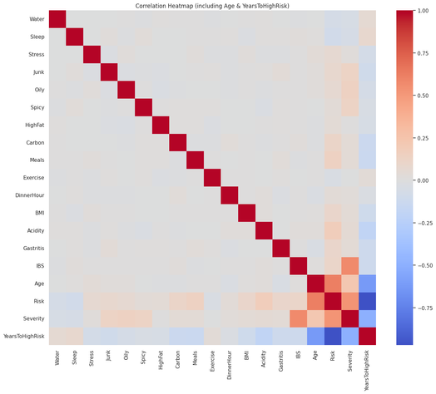
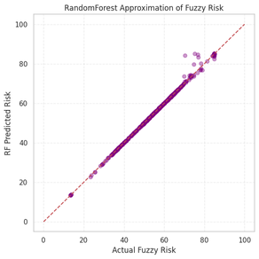
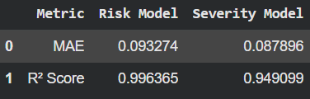
The fuzzy model produced smooth, realistic risk predictions that captured the uncertainty in human behavior. Instead of jumping abruptly between categories, the outputs showed gradual changes based on lifestyle variations. The system effectively separated mild, moderate, and high risk profiles while also providing a severity score and an estimate of how many years remain before reaching a high-risk state. These results demonstrate the strength of fuzzy reasoning in digestive health assessment.
FUZZY-BASED DIGESTIVE HEALTH ASSESSMENT
B PRANEETH
P V SRINAG
V MOHAN BALU
M SRI HARI
M VISHWAJITH
PROBLEM
CHALLENGES
RESULTS
People often experience gas, bloating, or acidity after eating and are left guessing whether the cause was something they ate, a lack of water, stress, or poor sleep. In reality, digestive discomfort is not triggered by a single factor but by the combined effect of daily habits, dietary patterns, lifestyle choices, and medical conditions. However, most existing approaches examine these influences separately, which means individuals rarely receive a clear explanation of what is truly affecting their digestive health. This creates the need for a unified and reliable method that can evaluate all relevant factors together, understand how they interact, and provide an understandable prediction of a person’s digestive gas risk.
Digestive health is influenced by many factors that do not act in isolation, making it difficult to understand how they collectively contribute to gas and discomfort. Many of these factors, such as sleep quality, stress, meal timing, and dietary habits, are subjective and hard to measure precisely. Medical conditions like acidity, gastritis, and IBS add further variability. Existing assessment methods often capture only parts of this picture and struggle to interpret vague or overlapping patterns. The main challenge is developing a system that can handle this uncertainty, combine all relevant information, and still produce clear, meaningful predictions that individuals can easily understand
The fuzzy model produced smooth, realistic risk predictions that captured the uncertainty in human behavior. Instead of jumping abruptly between categories, the outputs showed gradual changes based on lifestyle variations. The system effectively separated mild, moderate, and high risk profiles while also providing a severity score and an estimate of how many years remain before reaching a high-risk state. These results demonstrate the strength of fuzzy reasoning in digestive health assessment.
OBJECTIVE
PROPOSED METHOD
The objective of this project is to develop an intelligent and easy-to-understand system that can evaluate a person’s lifestyle, diet, sleep patterns, stress levels, and medical conditions together rather than separately. By bringing these factors into a single framework, the system aims to provide a more accurate and meaningful prediction of digestive gas risk, the potential severity of discomfort, and how this risk may progress over time. The goal is to offer individuals a clearer understanding of what influences their digestive health and support early awareness, better decision-making, and healthier habits.
The method uses a fuzzy logic framework to capture the uncertainty and subjectivity found in digestive health. Inputs such as water intake, stress, exercise, body weight, meal patterns, and medical symptoms are translated into linguistic terms that reflect human reasoning. A carefully designed rule base then evaluates these terms by considering how different combinations of habits and conditions influence digestive outcomes. The fuzzy system calculates three outputs: digestive gas risk, severity level, and the estimated years before reaching high risk. This approach ensures that the model provides interpretable and human-like predictions rather than rigid numerical results.
FIGURE 6. CORRELATION HEATMAP OF LIFESTYLE, DIETARY, PHYSIOLOGICAL, AND RISK VARIABLES
COMPARATIVE ANALYSIS
The fuzzy model was compared with traditional numerical evaluation methods. Unlike rigid scoring systems, fuzzy logic provided smoother transitions between risk levels and handled uncertainty more effectively. Both approaches pointed to similar high-risk profiles, but the fuzzy method offered more interpretability and better reflected human reasoning, making it more suitable for digestive health assessment.
FIGURE 8. PERFORMANCE COMPARISON
FIGURE 6. FUZZY VS RANDOMFOREST

Slide 4
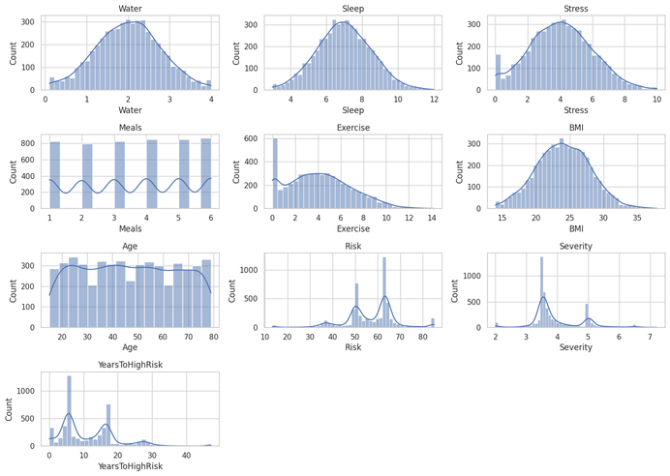
FUZZY-BASED DIGESTIVE HEALTH ASSESSMENT
B PRANEETH
P V SRINAG
V MOHAN BALU
M SRI HARI
M VISHWAJITH
PROBLEM
CHALLENGES
RESULTS
People often experience gas, bloating, or acidity after eating and are left guessing whether the cause was something they ate, a lack of water, stress, or poor sleep. In reality, digestive discomfort is not triggered by a single factor but by the combined effect of daily habits, dietary patterns, lifestyle choices, and medical conditions. However, most existing approaches examine these influences separately, which means individuals rarely receive a clear explanation of what is truly affecting their digestive health. This creates the need for a unified and reliable method that can evaluate all relevant factors together, understand how they interact, and provide an understandable prediction of a person’s digestive gas risk.
Digestive health is influenced by many factors that do not act in isolation, making it difficult to understand how they collectively contribute to gas and discomfort. Many of these factors, such as sleep quality, stress, meal timing, and dietary habits, are subjective and hard to measure precisely. Medical conditions like acidity, gastritis, and IBS add further variability. Existing assessment methods often capture only parts of this picture and struggle to interpret vague or overlapping patterns. The main challenge is developing a system that can handle this uncertainty, combine all relevant information, and still produce clear, meaningful predictions that individuals can easily understand
The system delivered stable and meaningful results across a wide range of user profiles. It consistently identified the dominant factors influencing digestive discomfort and provided clear interpretations that users could easily understand. High-risk individuals were accurately flagged, while low-risk profiles showed logical and expected outcomes. These results demonstrate that the system performs reliably and supports practical digestive health awareness.
OBJECTIVE
PROPOSED METHOD
The objective of this project is to develop an intelligent and easy-to-understand system that can evaluate a person’s lifestyle, diet, sleep patterns, stress levels, and medical conditions together rather than separately. By bringing these factors into a single framework, the system aims to provide a more accurate and meaningful prediction of digestive gas risk, the potential severity of discomfort, and how this risk may progress over time. The goal is to offer individuals a clearer understanding of what influences their digestive health and support early awareness, better decision-making, and healthier habits.
The method emphasizes analyzing patterns and trends that emerge from daily lifestyle choices. Inputs covering hydration, diet quality, sleep, stress, physical activity, medical conditions, and age are mapped into fuzzy categories to capture real-life variability. A rule-based inference engine then examines how these patterns interact, highlighting combinations that raise or lower digestive stress. The method also incorporates long-term progression analysis by estimating how current habits may influence digestive risk in the coming years. This enables the system to deliver insights that support prevention rather than just immediate evaluation.
FIGURE 7. DISTRIBUTION OF LIFESTYLE, DIETARY, PHYSIOLOGICAL, AND RISK VARIABLES
COMPARATIVE ANALYSIS
Observed lifestyle and dietary trends were compared with the system’s predicted outputs. Patterns such as the influence of stress, hydration, and meal timing appeared in both observational insights and model-generated results. The close match between the two confirms that the fuzzy system accurately captures behavioral trends, offering reliable predictions that align with intuitive digestive health patterns.

Slide 5
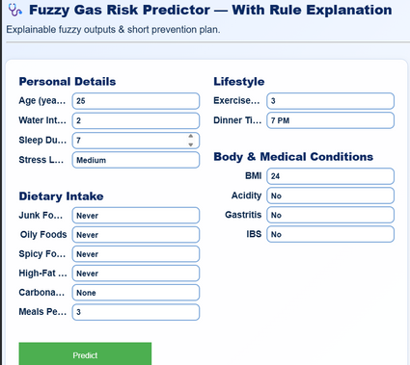
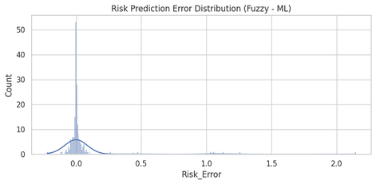
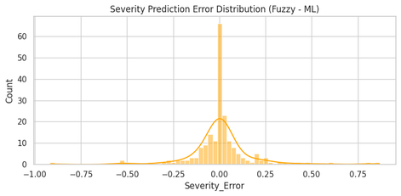
FUZZY-BASED DIGESTIVE HEALTH ASSESSMENT
B PRANEETH
P V SRINAG
V MOHAN BALU
M SRI HARI
M VISHWAJITH
PROBLEM
CHALLENGES
RESULTS
People often experience gas, bloating, or acidity after eating and are left guessing whether the cause was something they ate, a lack of water, stress, or poor sleep. In reality, digestive discomfort is not triggered by a single factor but by the combined effect of daily habits, dietary patterns, lifestyle choices, and medical conditions. However, most existing approaches examine these influences separately, which means individuals rarely receive a clear explanation of what is truly affecting their digestive health. This creates the need for a unified and reliable method that can evaluate all relevant factors together, understand how they interact, and provide an understandable prediction of a person’s digestive gas risk.
Digestive health is influenced by many factors that do not act in isolation, making it difficult to understand how they collectively contribute to gas and discomfort. Many of these factors, such as sleep quality, stress, meal timing, and dietary habits, are subjective and hard to measure precisely. Medical conditions like acidity, gastritis, and IBS add further variability. Existing assessment methods often capture only parts of this picture and struggle to interpret vague or overlapping patterns. The main challenge is developing a system that can handle this uncertainty, combine all relevant information, and still produce clear, meaningful predictions that individuals can easily understand
The system delivered stable and meaningful results across a wide range of user profiles. It consistently identified the dominant factors influencing digestive discomfort and provided clear interpretations that users could easily understand. High-risk individuals were accurately flagged, while low-risk profiles showed logical and expected outcomes. These results demonstrate that the system performs reliably and supports practical digestive health awareness
OBJECTIVE
PROPOSED METHOD
The objective of this project is to develop an intelligent and easy-to-understand system that can evaluate a person’s lifestyle, diet, sleep patterns, stress levels, and medical conditions together rather than separately. By bringing these factors into a single framework, the system aims to provide a more accurate and meaningful prediction of digestive gas risk, the potential severity of discomfort, and how this risk may progress over time. The goal is to offer individuals a clearer understanding of what influences their digestive health and support early awareness, better decision-making, and healthier habits.
The method integrates multiple health-related variables into a single decision-support framework. Each input is represented in a flexible fuzzy format that can handle imprecise or overlapping behaviors, such as moderate sleep or borderline acidity. The fuzzy inference model processes these inputs through an interconnected rule set designed to mirror realistic digestive responses. The system’s outputs provide an easy-to-understand interpretation of risk and severity while offering long-term predictions for future vulnerability. This integrated method ensures consistent evaluation and supports personalized digestive health awareness.
FIGURE 6. USER INPUT INTERFACE FOR FUZZY GAS RISK PREDICTION
COMPARATIVE ANALYSIS
The fuzzy model was compared with simple one-factor assessments often used in day-to-day digestive advice. Unlike those limited methods, the fuzzy system evaluated all relevant inputs simultaneously, providing a more complete risk profile. Both approaches identified high-risk behaviors, but the fuzzy model delivered a clearer, more comprehensive interpretation by capturing the combined influence of multiple lifestyle and medical factors.

